Slide 1



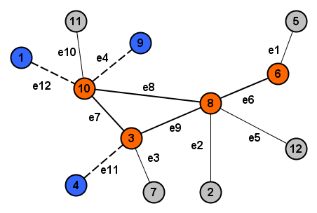
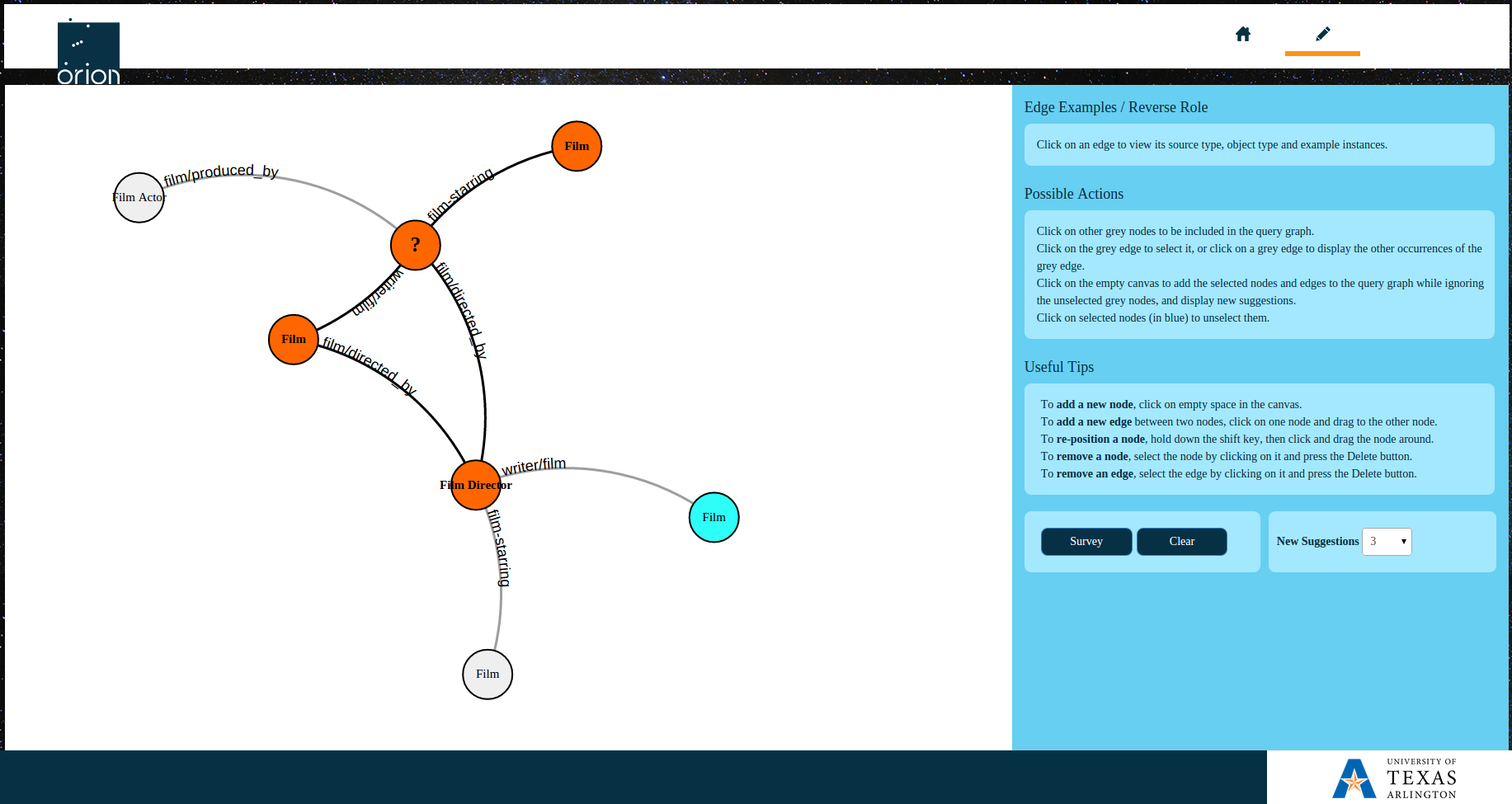
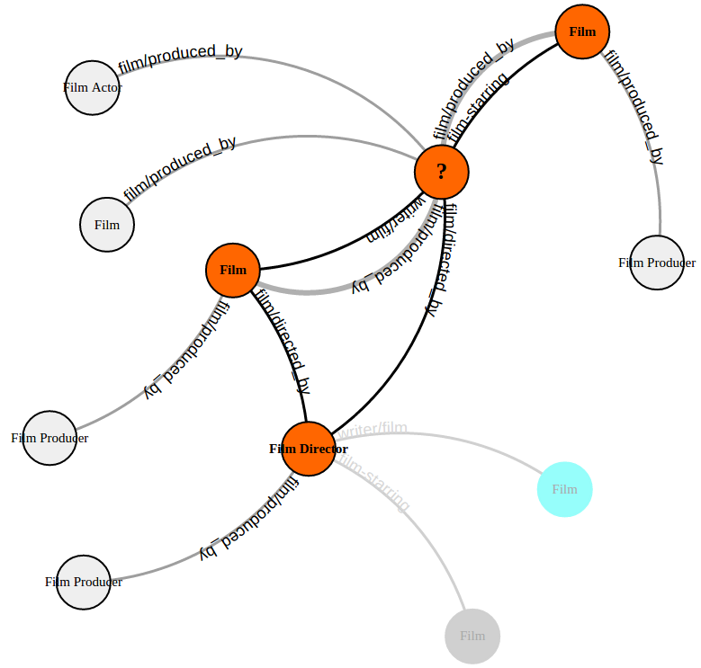
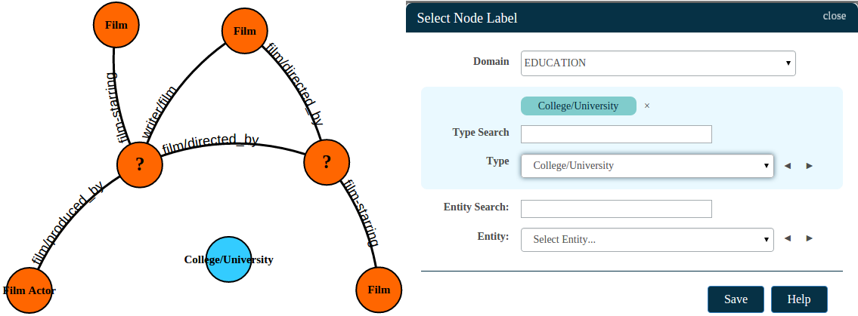
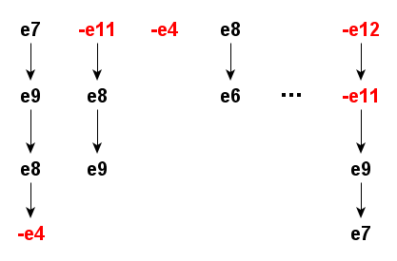
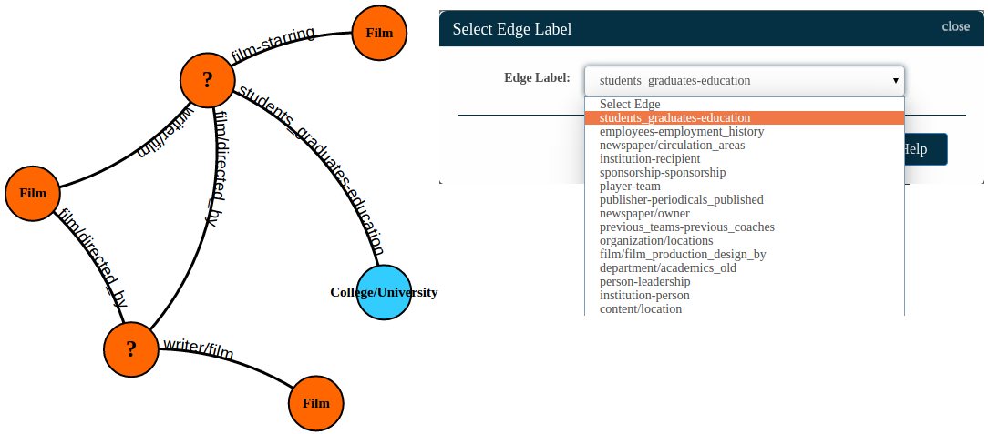
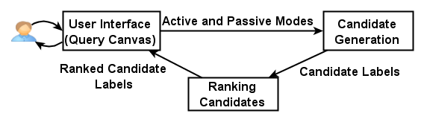

VIIQ: Auto-Suggestion Enabled Visual Interface for Interactive Graph Query Formulation
Nandish Jayaram, Sidharth Goyal*, Chengkai Li
University of Texas at Arlington
41st International Conference on Very Large Data Bases, Kohala Coast, Hawaii, Aug. 31st - Sept. 4th, 2015
idir.uta.edu/orion
Motivation
Ranking Candidates
Orion User Interface
Graphical query interfaces are widely recognized to be important for improving the usability of data management systems.
Limitations of Existing Visual Query Systems
They allow users to draw nodes and edges of query graphs, but do not rank relevant suggestions regarding what to add.
Difficult for schema-agnostic users to sift through and search for the exact option.
Positive Edges
Query Canvas
Option to view the types of an edge’s ends, and its example instances
Negative Edges
Newly suggested nodes and edges in grey
Dynamic help listing possible user actions at every step
Candidate Edges
Other useful tips
New Candidate Edges: <e1, e2, e3, e5, e10>
Positive Edges: <e6, e7, e8, e9>
Negative Edges: <e4, e11, e12>
Query Session: <e6, e7, e8, e9, -e4, -e11, -e12>
Query Log: A collection of other query sessions
Orange nodes with black edges form the partial query graph
Challenges
Click on a suggested grey node to add it to the query graph (color turns blue)
Information Panel
An interactive query interface that seamlessly integrates automatic edge recommendation with query formulation.
Large ultra-heterogeneous graphs contain thousands of node/edge types, and millions of node/edge instances as candidates.
Ranking must reflect the relevance to user’s query intent.
Passive Mode of operation
Random Correlation Paths (RCP)
Passive Mode of operation
Active Mode of operation
Adding a new node manually
RCP: A sequence of randomly chosen edges from the query session, grown incrementally, until its support drops below a threshold (t).
Already selected newly suggested node
Active Mode of operation
Orion Architecture
Each correlation path selects a subset of the query log, with no more than ‘t’ rows in it
Compute support for each candidate, in each correlation path
Find average score over all RCPs for each candidate edge
Click on an automatically suggested grey edge to view other instances of that edge
Adding a new edge manually
Rank candidate edges
Generate candidate edges
This work is partially supported by NSF grants IIS-1018865, CCF-1117369 and IIS-1408928. Any opinions, findings, and conclusions or recommendations expressed in this paper do not necessarily reflect the views of the funding agency.
* Work done as a student at UT-Arlington

